Slide 1


PANIMALAR ENGINEERING COLLEGE
Department of Electronics and Instrumentation Engineering
ORAL CANCER DETECTION USING
DEEP LEARNING
Batch No: 03
Batch Members:
Akshaya.B.C (211420107004)
Bhavitha Enuganti (211420107008)
Sangeetha.R (211420107022)
aaaaaasghjcvhgushuihjjkhh
Internal Guide:
V.Vasudhevan M.E.,
Assistant Professor
Department of ECE
Panimalar Engineering College.

Slide 2
ORGANIZATION
Objective of the Project
Introduction
Literature Survey
Existing System
Problem Identification
Proposed system - Block Diagram and Flow Chart
Algorithms used
Stages of Oral Cancer
Input Images
References

Slide 3
OBJECTIVE OF THE PROJECT
Our objectives are to develop a hybrid deep learning framework integrating RNN, LSTM, GRU, GAN, and autoencoders, along with traditional machine learning techniques, for oral cancer detection. We aim to improve accuracy and robustness in distinguishing between cancerous and non-cancerous cases, enabling early diagnosis and treatment.

Slide 4
INTRODUCTION
The introduction of our study presents a novel approach to oral cancer detection by integrating multiple deep learning architectures into a hybrid framework. We outline the significance of early detection in improving patient outcomes and healthcare efficiency. By combining image feature extraction using RNN, LSTM, GRU, GAN, and autoencoders with clinical data analysis employing traditional machine learning techniques, our framework aims to enhance the accuracy and robustness of oral cancer detection. We emphasize the need for comprehensive feature representation and evaluation using standard metrics such as accuracy, sensitivity, and specificity to validate the efficacy of our approach in early diagnosis and intervention.

Slide 5
LITERATURE SURVEY
Title | Authors | Publisher | Year | Algorithms Used/ Achievements | Limitations
Advanced Meta-Heuristic Algorithm Based on Particle Swarm and Al-Biruni Earth Radius Optimization Methods for Oral Cancer Detection | H. Myriam; A. A. Abdelhamid; E. -S. M. El-Kenawy; A. Ibrahim; M. M. Eid; M. M. Jamjoom; D. S. Khafaga | IEEE | 2023 | - Convolutional Neural Network (CNN) and optimized Deep Belief Network (DBN). - Development of a hybrid optimization algorithm (PSOBER) combining Particle Swarm Optimization (PSO) and Al-Biruni Earth Radius (BER) Optimization. - Achieved an accuracy of 97.35% on a standard biomedical images dataset from Kaggle. | Algorithms Used/Achievements: Limitations: - Reliance on a single dataset may limit generalizability. - Further validation on larger datasets is necessary. - Limited exploration of additional oral features for cancer detection.
Multimodal Transfer Learning for Oral Presentation Assessment | S. S. Y. Tun; S. Okada; H. -H. Huang; C. W. Leong | IEEE | 2023 | The paper employs transfer learning techniques to leverage knowledge from a job interview dataset for pretraining and then adapt it to a smaller presentation dataset. This approach aims to enhance the learning process and improve performance in evaluating oral presentation skills | The transferability of knowledge between the job interview dataset and the presentation dataset might be limited by domain-specific nuances. Certain aspects of oral communication and performance evaluation may differ between these contexts, potentially impacting the generalization capability of the model.
Unveiling the Future of Oral Squamous Cell Carcinoma Diagnosis: An Innovative Hybrid AI Approach for Accurate Histopathological Image Analysis | I. U. Haq; M. Ahmed; M. Assam; Y. Y. Ghadi; A. Algarni | IEEE | 2023 | This approach combines Gabor filtering, which is effective in texture analysis, with CatBoost, a gradient boosting algorithm known for its robustness and efficiency in classification tasks. While specifics on the achieved performance metrics are not provided, this method likely yielded promising results given its utilization of both low-level feature extraction and advanced machine learning techniques. | The study does not provide information on the diversity of datasets used for training and testing. It is essential to assess the algorithm's performance on diverse datasets to ensure its generalizability across different populations, imaging conditions, and equipment.

Slide 6
LITERATURE SURVEY
Title | Authors | Publisher | Year | Algorithms Used/ Achievements | Limitations
Aligning Small Datasets Using Domain Adversarial Learning: Applications in Automated in Vivo Oral Cancer Diagnosis | K. Caughlin; E. Duran-Sierra; S. Cheng; R. Cuenca; B. Ahmed; J. Ji; M. Martinez; M. Al-Khalil; H. Al-Enazi; Y. -S. L. Cheng; J. Wright; J. A. Jo; C. Busso | IEEE | 2023 | Integration of a domain adaptation module into the neural network architecture to encourage domain invariance between two multispectral autofluorescence imaging (maFLIM) datasets. | Incorporating domain adaptation techniques into the neural network architecture increases computational complexity and training time, which may hinder scalability and deployment in real-world clinical settings with limited computational resources.
A Multifaceted Approach to Oral Assessment Based on the Conformer Architecture | Z. Fan; J. Li; A. Wumaier; Z. Kadeer; A. Abdurahman | IEEE | 2023 | This method effectively increases the model's ability to capture local feature information at different scales, enhancing the model's performance in mispronunciation detection and pronunciation quality assessment tasks. | The experiments are conducted on self-built and open-source datasets, which may not fully represent the diversity of real-world speaking scenarios. The generalizability of the proposed method to other languages and dialects remains uncertain.
The Minimally-Invasive Oral Glucose Minimal Model: Estimation of Gastric Retention, Glucose Rate of Appearance, and Insulin Sensitivity from Type 1 Diabetes Data Collected in Real-life Conditions | E. Faggionato; M. Schiavon; L. Ekhlaspour; B. A. Buckingham; C. Dalla Man | IEEE | 2023 | This method was utilized to identify the parameters of the Oral Minimal Model (OMM) and the physiological model of glucose transit through the gastrointestinal tract (R-OMM) from plasma glucose (G) and insulin (I) measurements. | The study's sample size of forty-seven individuals with type 1 diabetes may not fully capture the variability present in the population, limiting the generalizability of the findings.

Slide 7
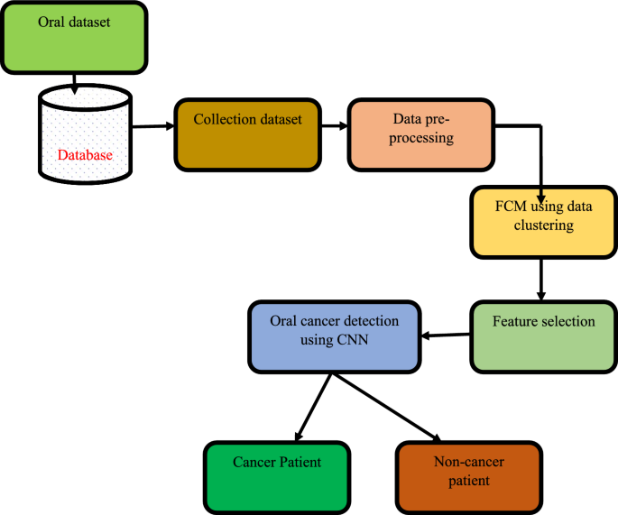
BLOCK DIAGRAM OF EXISTING SYSTEM

Slide 8
PROBLEM IDENTIFICATION/
LIMITATIONS OF EXISTING SYSTEM
The existing systems for oral cancer detection often face limitations in terms of accuracy and robustness. Traditional methods may rely solely on clinical data or image analysis, leading to suboptimal performance due to the complexity and variability of oral cancer manifestations. Additionally, these systems may struggle with feature representation and integration, hindering their ability to distinguish between cancerous and non-cancerous cases effectively. Moreover, the lack of comprehensive evaluation using standard metrics may limit the reliability of their results. These limitations underscore the need for a more advanced approach that combines deep learning architectures and traditional techniques to improve the accuracy and reliability of oral cancer detection systems.

Slide 9
OVERVIEW OF THE PROPOSED WORK
The proposed system addresses the limitations of existing oral cancer detection methods by introducing a hybrid deep learning framework. This framework integrates multiple deep learning architectures, including RNN, LSTM, GRU, GAN, and autoencoders, with traditional machine learning techniques for comprehensive feature representation and analysis. By preprocessing and combining diverse datasets encompassing oral images and clinical information, our system aims to improve accuracy and robustness in distinguishing between cancerous and non-cancerous cases. Through feature fusion and classification, we strive to enhance the efficacy of early detection and diagnosis of oral cancer. Evaluation using standard metrics such as accuracy, sensitivity, and specificity will validate the performance of our approach, demonstrating its potential to revolutionize oral cancer screening tools and improve patient outcomes.

Slide 10
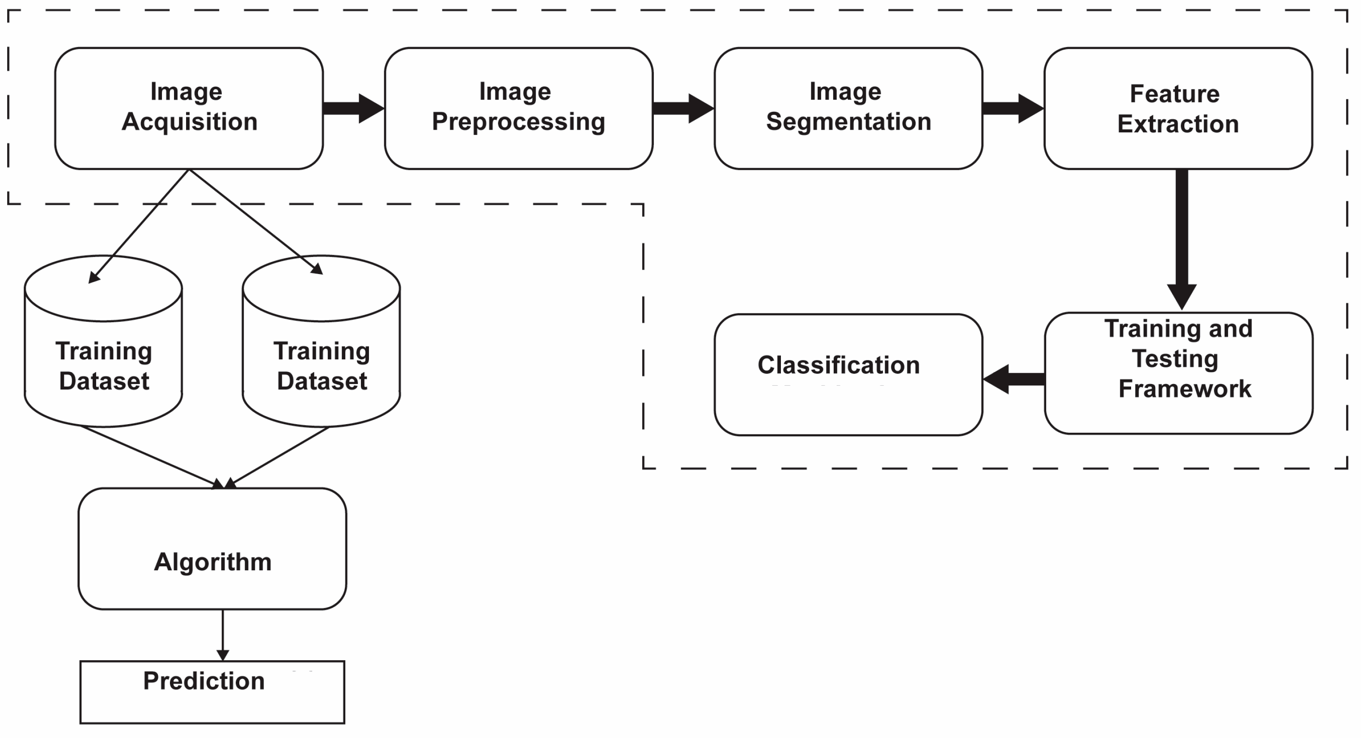
BLOCK DIAGRAM OF PROPOSED SYSTEM

Slide 11
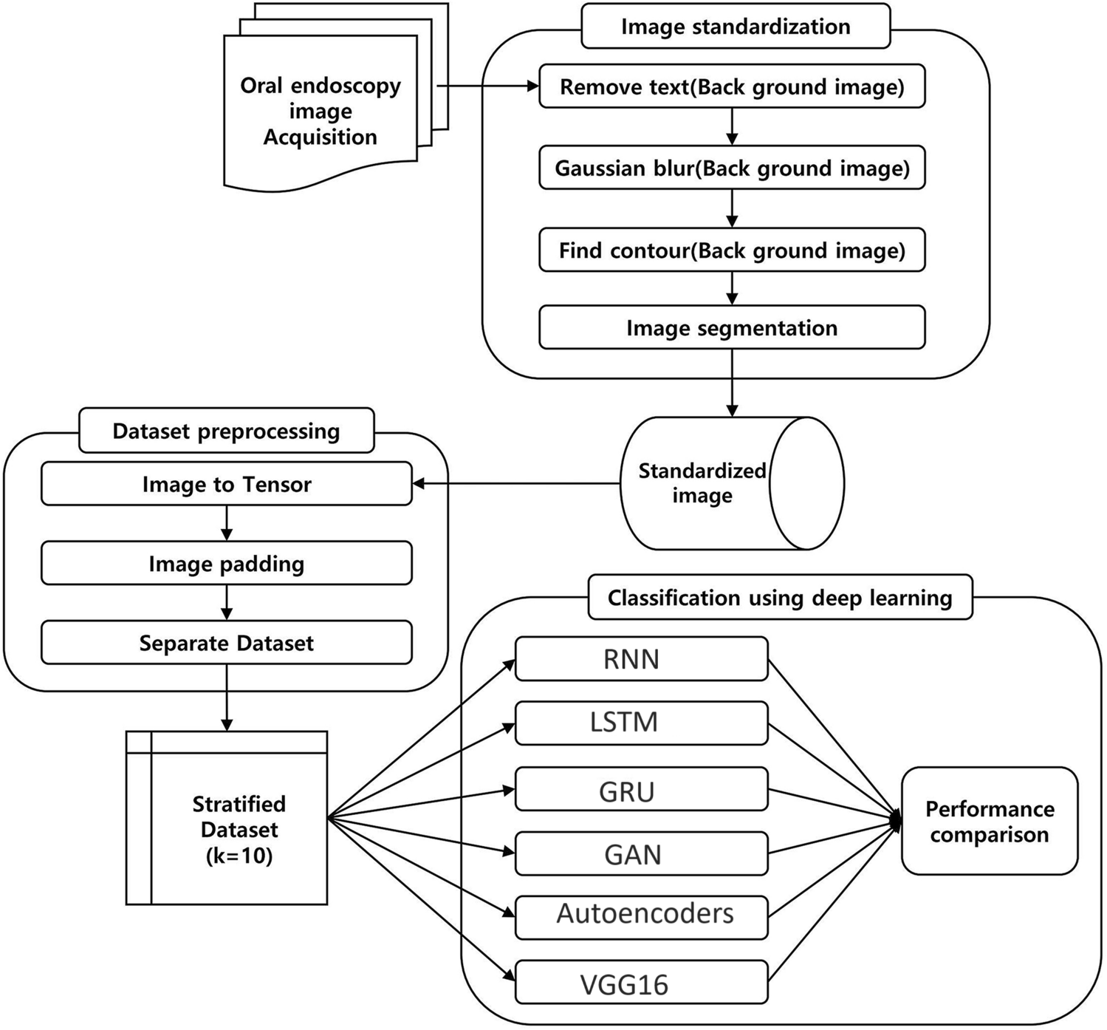
FLOW CHART OF PROPOSED SYSTEM

Slide 12
ALGORITHM USED
1.Recuurent Neural Networks (RNN).
2.Long Short-Term Memory Networks (LSTM).
3.Gated Recurrent Units (GRU).
4.Generative Adversarial Networks (GAN).
5.Autoencoders VGG16

Slide 13
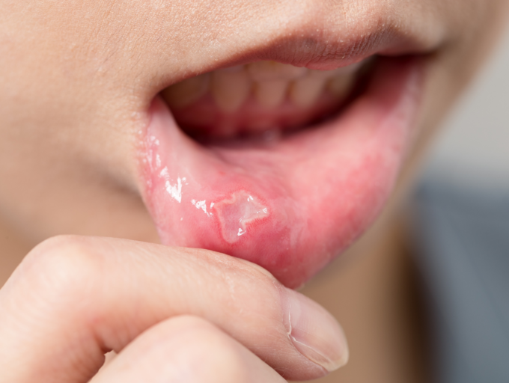
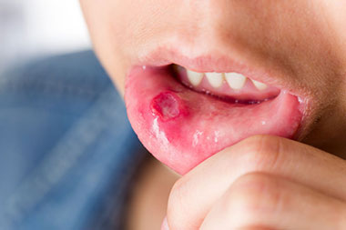
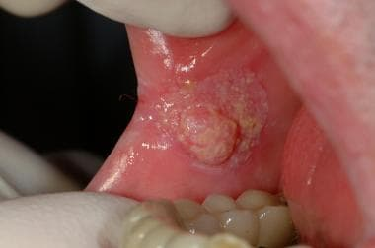
STAGES OF ORAL CANCER
STAGE 0: The cancer is only in the lining of the mouth or lips.
STAGE 1:This is the earliest stage of invasive cancer. It means the tumor is 2 cm or smaller.
STAGE 2:The tumor is larger than 2 cm but no more than 4 cm.

Slide 14
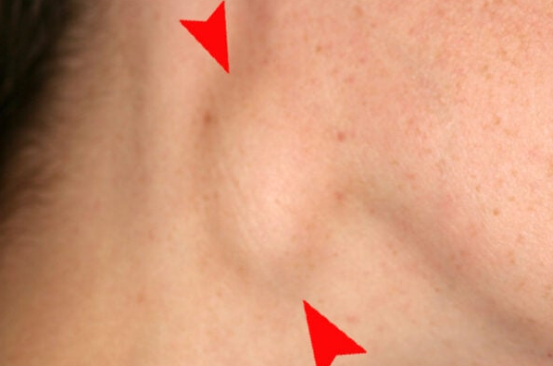
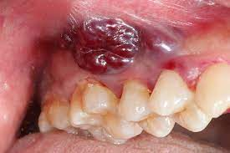
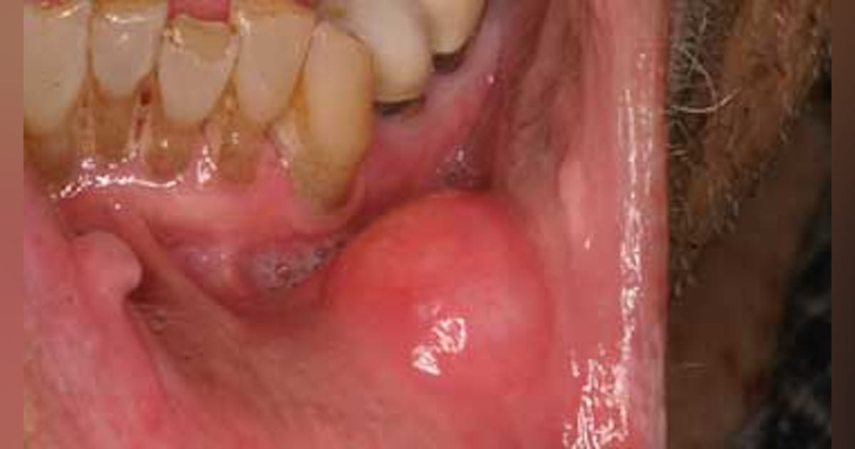
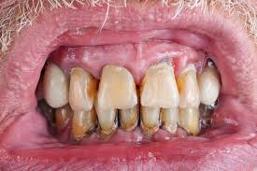
STAGES OF ORAL CANCER
STAGE 3: The tumor is larger than 4 cm or the cancer has spread to one lymph node in the neck on the same side as the tumor and the lymph node is 3 cm or smaller.
STAGE 4:The tumor is any size and has grown into any of the following:
the bone in the palate or lower jaw
a nerve in the lower jaw called the inferior alveolar nerve
floor of the mouth
skin of the face
The cancer may also have spread to 1 or more lymph nodes in the neck, and they are 6 cm or smaller.

Slide 15
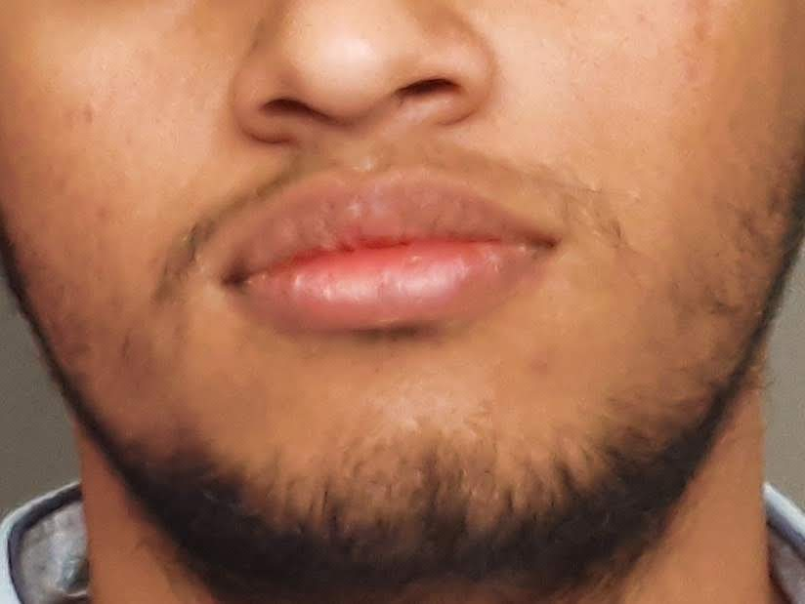
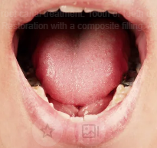
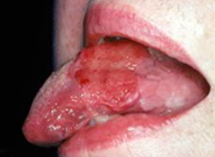
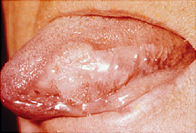
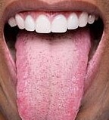

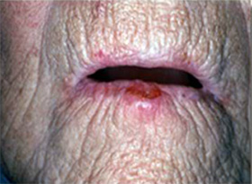
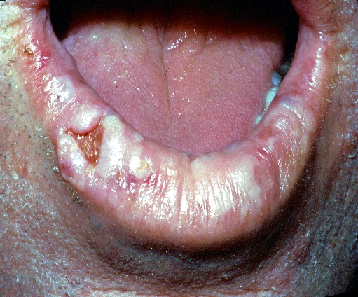
INPUT IMAGES
NON-CANCER IMAGES
ORAL CANCER IMAGES

Slide 16
REFERENCES
Dempster, A.G., and Macleod M.D. : “ Use of minimum adder multiplier blocks in FIR digital filtes”. IEEE Trans. Circuits Syst. II, Analog Digital Signal Process., 1995, 42, (9), pp 569 – 577.
Bull, D.R. and Horrocks, D.H.: “Primitive operator digital filters”. IEEE Proc. G. Circuits Devices Syst., 1991, 138, (3), pp, 401 – 412.

Slide 17


